Slide 1

Online Store
February sales declined primarily due to decreased performance in two Product Lines
High sales volume occurs on Weekends and Tuesdays, with no peak hours during daily operations
January sales were high, peaking in the 4th week, while February and March peaked in the second week
Home and Lifestyle was the only Product Line with a January rating below 80% and experienced a significant decline in February
Different cities have varying preferences for Product Lines and payment methods
Normal members shop more on weekends, accounting for nearly 50% of transactions. Increasing member percentage will provide more member data for marketing purposes
Male members drive the highest sales in Health and Beauty, while female members contribute the least to this Product Line
January's bad ratings were primarily from Home and Lifestyle. More rating details are needed for improvement
Nguyen Thi Tuong Vy

Slide 2
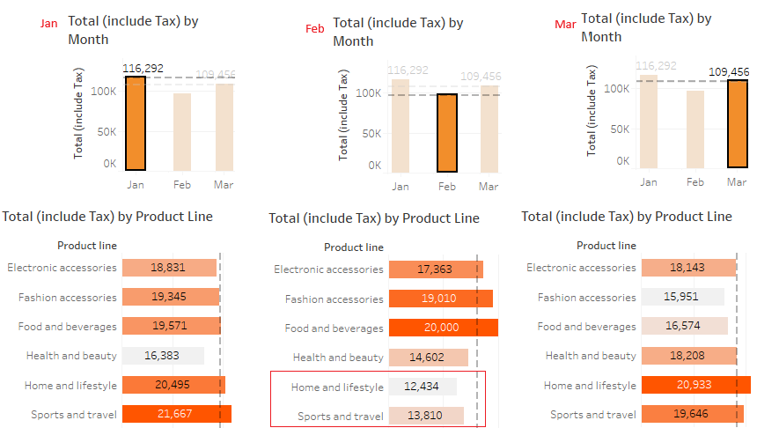
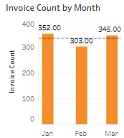
Online Store
1. February sales declined primarily due to decreased performance in two Product Lines

Slide 3
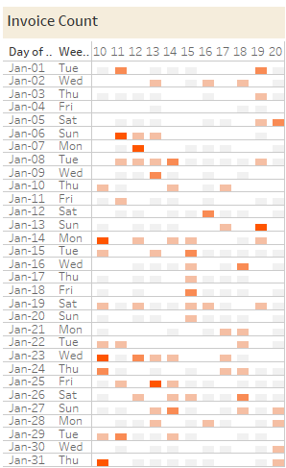
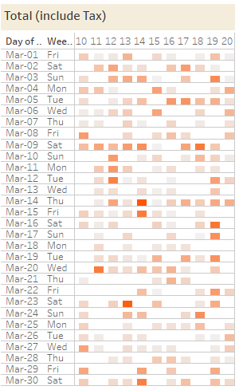
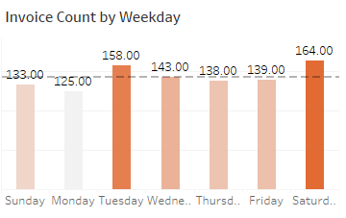
Online Store
2. High sales volume occurs on Weekends and Tuesdays, with no peak hours during daily operations

Slide 4
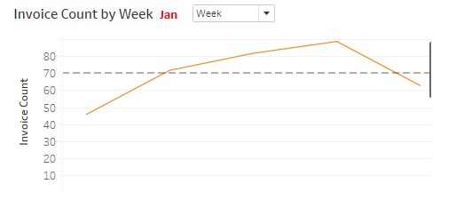
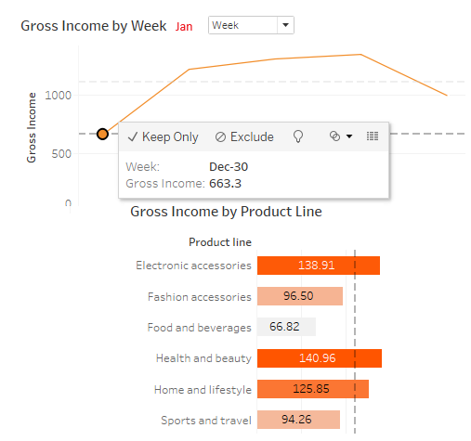
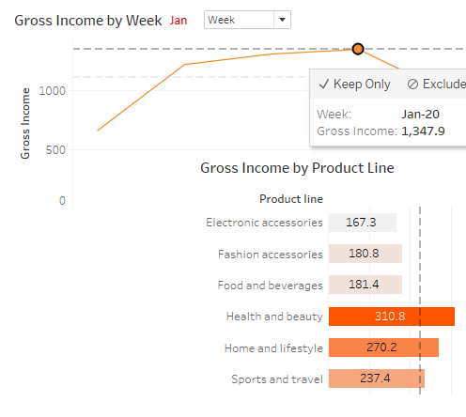
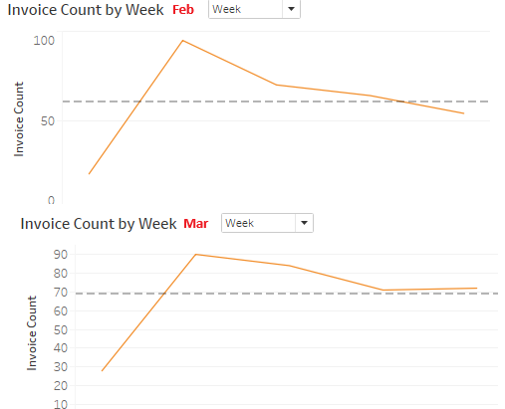
Online Store
3. January sales were high, peaking in the 4th week, while February and March peaked in the second week

Slide 5
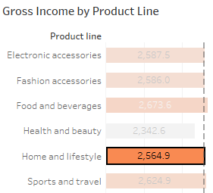
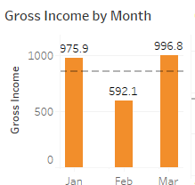

Online Store
4. Home and Lifestyle was the only Product Line with a Jan rating below 80% and experienced a significant decline in Feb

Slide 6
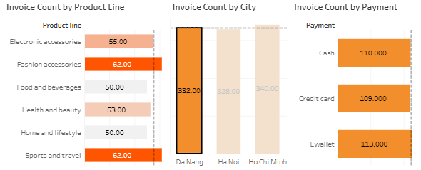
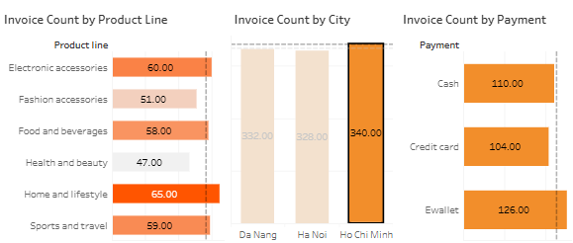
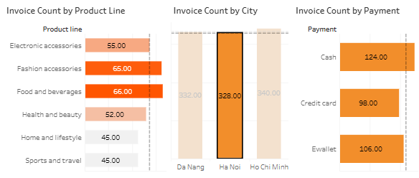
Online Store
5. Different cities have varying preferences for Product Lines and payment methods

Slide 7
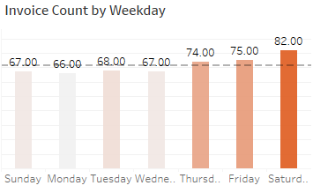
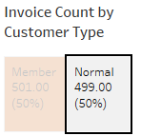
Online Store
6. Normal members shop more on weekends, accounting for nearly 50% of transactions. Increasing member percentage will provide more member data for marketing purposes

Slide 8
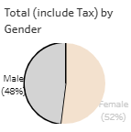
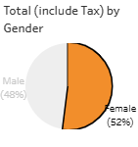
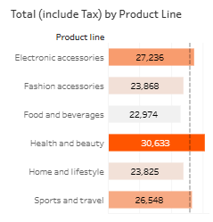
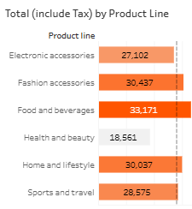
Online Store
7. Male members drive the highest sales in Health and Beauty, while female members contribute the least to this Product Line

Slide 9
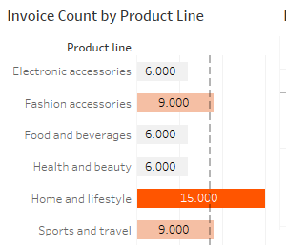
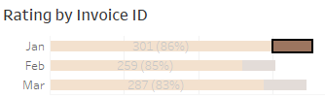
Online Store
8. January's bad ratings were primarily from Home and Lifestyle. More rating details are needed for improvement

